Slide 1
Noise Pollution and its assessment

Slide 2
www.MINEPORTAL.in
ONLINE TEST SERIES FOR
COAL/METAL FIRST/SECOND CLASS EXAM
GATE MINING EXAMS
PSUs MTs EXAM
MINING SIRDAR/OVERMAN EXAMS
FREE STUDY MATERIAL
MINING JOBS NOTIFICATION
MINEPORTAL APP AVAILABLE IN GOOGLE PLAY STORE
www.MINEPORTAL.in Call/Whatsapp- 8804777500 www.fb.com/mineportal.in

Slide 3
Noise Sound
Unwanted and irritated sound Mechanical vibration in any media
        No demarcation line
        Depends on activation level of mind
Sound source Radiate energy acoustic watt ( very wide range) logarithm scale
Decibel (db) = 10 log(A/A₀) Quantity A relative to A₀
Decibel is used in environmental noise pollution as a measure of sound power level, sound intensity level and sound pressure level

Slide 4
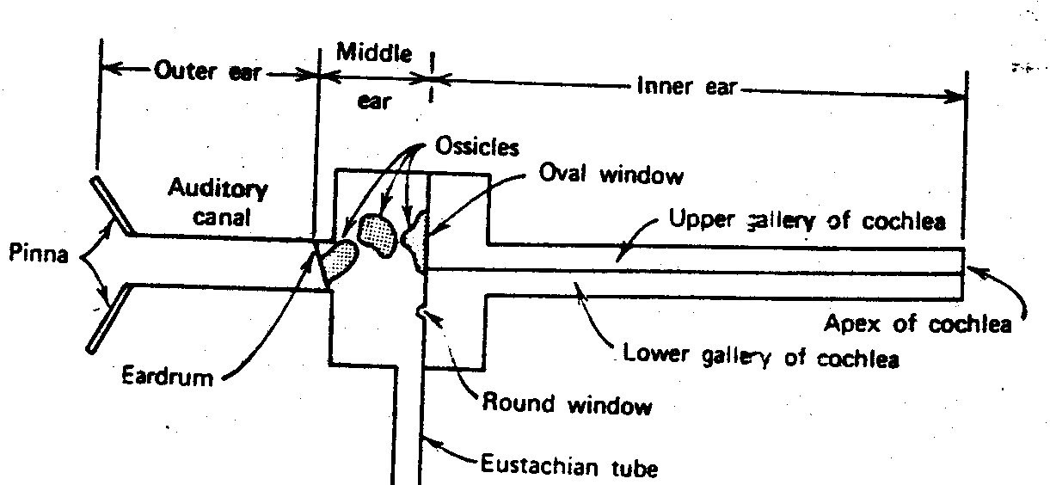
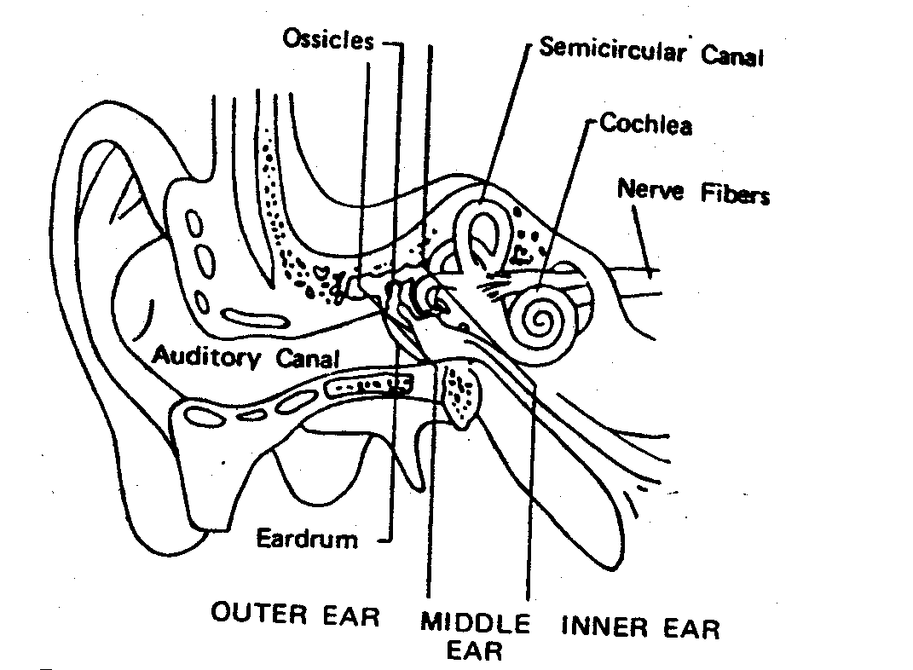
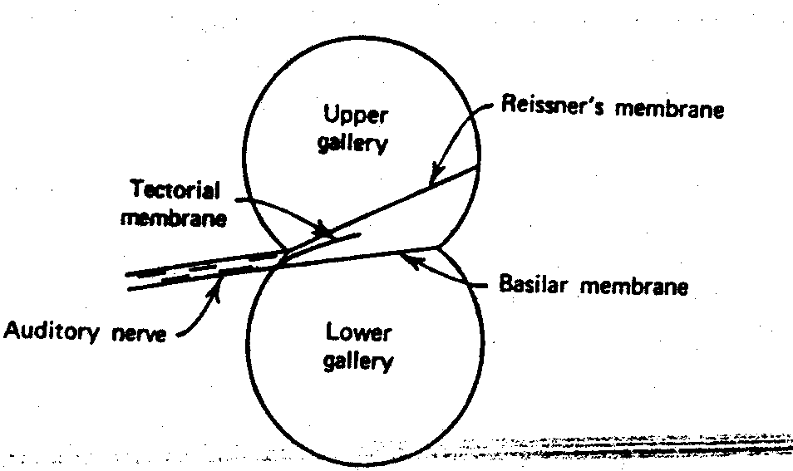
Speech and hearing
How we hear ? Loudness and loudness level Audiometry

Slide 5
Sound power level , L_{w} = 10 log (W/W₀), db re W₀
W = sound power in watts of a given source
W₀ = reference sound power, generally 10⁻¹² W
Relation ship between Sound power and sound power level
Sound power Sound power level
1000 150
100 140
10 130
1 120
0.1 110
0.01 100
0.001 90
.0001 80

Slide 6
Sound intensity level L_{I} = 10 log(I/I₀); db re I₀
I= sound intensity in watts per square meter
I₀= reference sound intensity, generally 10⁻¹² W/m²
Sound pressure level L_{p} = 10 log(p²/p₀²)
p = root mean square sound pressure in Pascal's
p₀ = reference root – mean square sound pressure, generally 2 x 10⁻⁵ Pa
Relationship
Free feel sound situation
L_{I} = L_{P}
Progressive spherical wave L_{W} = L_{I} + 10 log (S/S₀)
S = surface area of a sphere in square meters
S₀ = reference area of 1 m²

Slide 7
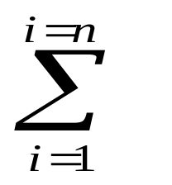
Multiple Sound sources
L_{P} = 10 log p_{res}.²/p₀² = 10 log ( 10 ^{l1/10} + 10 log ^{l2/10})
Example Two source – 90 db each – resultant 93db
- 80 db each – resultant 83 db each
- 90, 90, 93, 96, 99 db each – resultant – 102 db each
L_{eq} = Level of equivalance = 10 log f_{i} 10 ^{li/10}
L_{i} = sound pr level of situation I
f_{i} = fraction of time for situation I at i_{th} position
MAX L
MIN L
Leq – single sound level index which taken into account the equivalance sound level exposure due to various sound fluctuating situation

Slide 8
Ldn – day night situation or level
L_{dn} = 10 log [ 15/24 10 ^{Leq(d)/10} + 9/24 10 ^{Leq ((n) +10)/10)}]
Very useful in Impact analysis
Standard norms
Area Day (db) Night (db)
Residential 55 45
Commercial 65 55
Sensitive 50 40
Industrial 75 70
rules as per DGMS circular, CPCB circular
Day 6 A.M. – 9 P.M. ;Night 9 p.m. – 6 a.m.;As per CPCB ,

Slide 9
Effects of noise
Auditory Effects - Deafness
TNITS – Temporary noise induced threshold shift
PNITS – Permanent nose induce threshold shift
Physiological effect
Vasoconstriction reflux
Dilation of pupils, paling of skin, tensing of voluntary and involuntary muscles, diminution of gastric secretion, increase in diastolic blood pressure.
Injection of adrenalin into blood stream increasing neuromuscular tension, nervousness, irritability and anxiety
Startled response
Performance effects
High frequency noise produce more interference than low frequency
Communication problem
Accuracy of work – not overall but variability in rate of work
Irregular burst are more disruptive then steady one

Slide 10
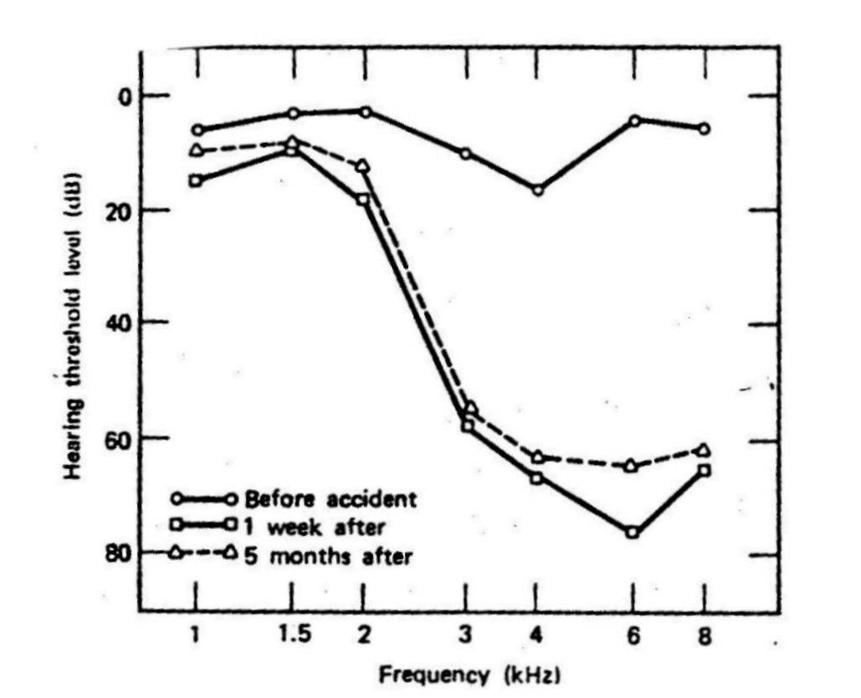

Slide 11
Special noise Environment
Fundamental frequencies of pipe organ -16 to 8000 Hz,
-widest frequency range of any musical instrument.
Infrasound < 16 Hz, not in audible range, presence cam be felt, beach, earthquake, thunder, wind turbulence, some man made sources – heating and air conditioning system, jet air craft and space craft during blast off.
Under laboratory condition findings- performing mental work as well as general sense of discomfort. As intensity increases dizziness, fatigue, discomfort, nausea, loss of balance in some cases. At higher level internal organs vibrate, causing pain and possible death.
      Natural conditions – hypothesis that animal and some people are visibly upset before some natural disaster

Slide 12
      Ultrasound Above 20,000 Hz- jet engines, high speed drills, cleaning devices and special tools used in the science of ultrasounds.
      Some applications – ultrasonic cleaning of teeth, detecting flaws in metals, listening to the heart movement of fetus and physical therapy
      Adverse effects – Excessive fatigue, nausea, headaches, vomiting when working in the vicinity of ground tested jet engines.
      Impulse Noise
      When hammer strikes a nail or a gun is fired, the sound pressure rises abruptly and then decays over a short time interval.
      Hand guns, toy caps, firecrackers
      Peak pressure magnitude, the time duration and the number of impulses per unit time,
      No of impulses exceeds 10 per second, simply treat as continues instead of impulsive

Slide 13
Sonic boom
      When an aircraft speed exceeds the speed of sound, sound waves cannot move ahead of the aircraft. Cone . Shaped shock waves are formed that moved outward like water waves from a ship’s bow.
      Govt. studies – damage to residential windows, plaster walls.
      Based on study – little or no public annoyance is expected to result from one sonic boom during the daytime below the level of 35.01 Pa as , measured on ground.
      Peal level = 35.91 / N^{1/2} , Pa N – no. of booms.
      Max, over pressure L_{P} = 125 – 10 log N
      sonic boom doubles – Lp decreased by 3dB.
Controlling of sound
Sound absorption
The sound absorption coefficient of a reflecting/absorbing surface is defined as the energy adsorbed during each reflection at specific frequency.
Surface – reflective – glass, plaster, hard surface - ≤ 0.05. Porous material – acoustic tiles, rugs, draperies – approaches unity.
ASTM C 423-66 – for manufacturers in establishing sound absorption coefficients. Noise reduction = 10 log ₁₀ [(a₀ + a_{a}) /a_{a}]
        a₀ = original absorption present in sabins
        a_{a}= added absorption in sabins

Slide 14
        Acoustic barrier
        Optical – diffraction theory has been applied to establish the sound attenuation loss caused by the presence of a straight solid thin wall.
        Fresnel number N = 2(A + B –d)/λ
        λ – wavelength of sound in meters
        A – distance between barrier and source
        B – distance between barrier and receiver
        D – distance between source and receiver
        Vibration isolation
        It is to be done to lower down or diminish vibration which may save the foundation and to diminish the re radiation of sound by vibrating body.
        steel springs
        Elastometer / resitent pad
        good vibration isolation over a range of frequencies subject to degradation in industrial environment From acid, oil and other corrosive material.
        air springs or air mounts – pneumatic isolation.
        Vibration damping

Slide 15
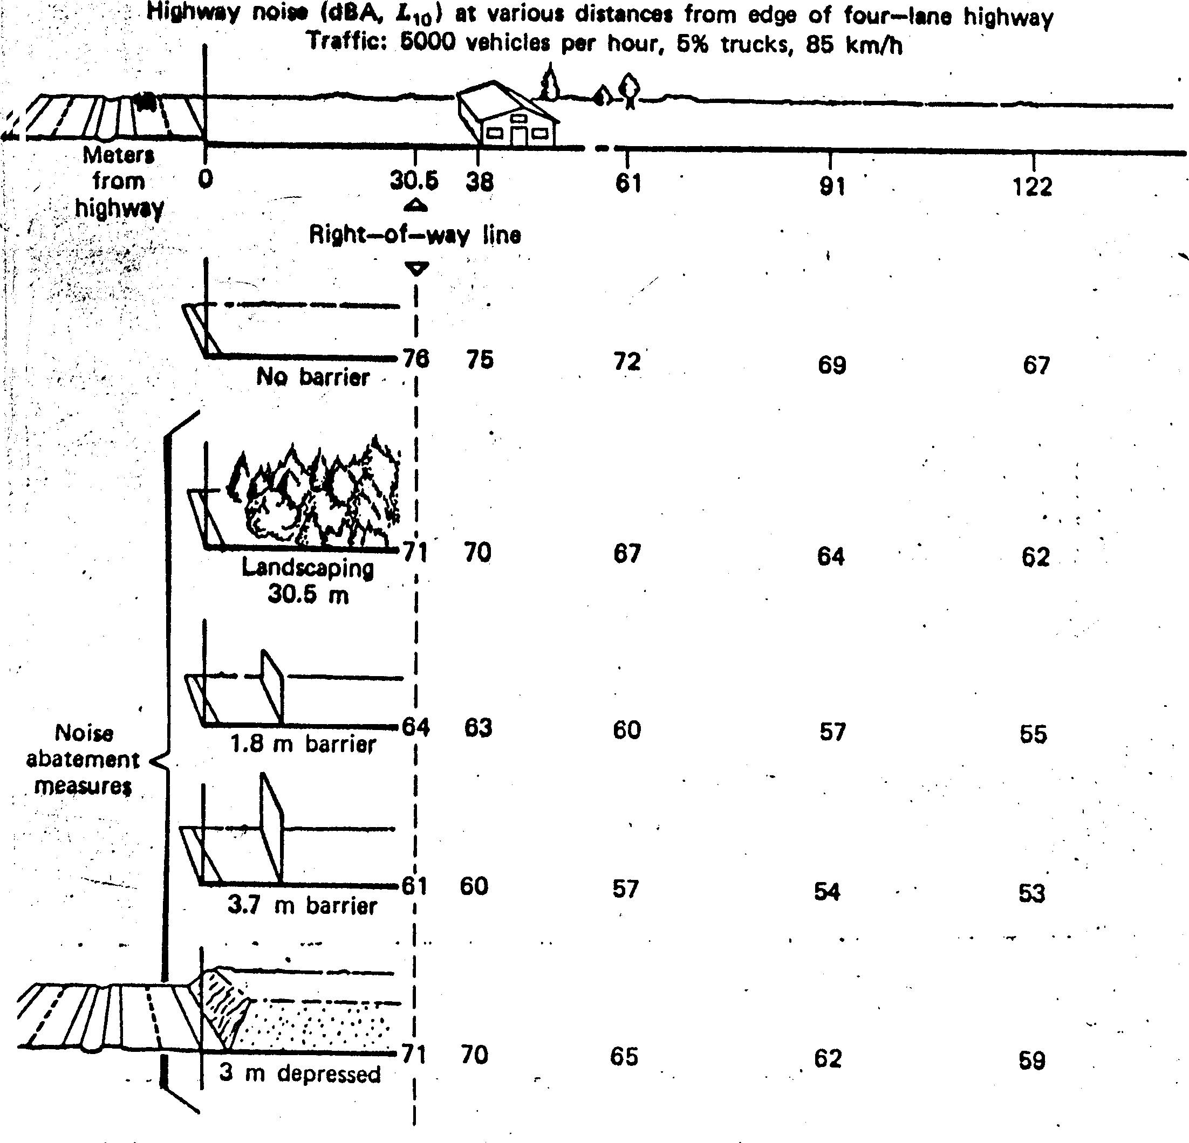
        Green belt

Slide 16
        Personnel protector this cant be treat as a noise control measure.
        Ear muff < 95 db - cheap
        Ear plug > 95 db
        discriminative personnel protector maximum attenuation 30 db - highest cost
        Muffling
        Reactive – Narrow band source – sound with single frequency
        Dissipative – Broad band sound situation – effective to all situation but costly

Slide 17
        Sound transmission loss
        Sound transmission loss of a partition is
        STL = 10 log (Ii/It) , dB
        Ii = sound intensity incident on one surface of the partition in wats per square meter
        It = Sound intensity radiated from the opposite surface of the partition in watts per square meter
        STL for partition between two reverberation rooms
        STL = L1 – L2 + 10 log (S/a)
L1 = time space average sound pressure level in the source room
L2 = time space average sound pressure level in the receiving room
S = total radiating surface area of the partition in square meters
a = total sound absorption in the receiving room in sabins
Measurement of sound
Sound level meter

Slide 18
Noise Monitoring
Ambient noise monitoring
Work site noise monitoring
Traffic noise Monitoring
Ambient
Assumption
Pre survey
Monitoring stations all 4 directions
Monitoring , duration time variable min. 10 minute at every 4 hrs ,.
Remarks wind speed, wind direction, temperature, humidity, possible sources, av. Distance of source etc.
Frequency spectrum analysis
Octave band analysis
        1/1 octave analyser
        1/2 octave analyser
        1//3 octave analyser

Slide 19
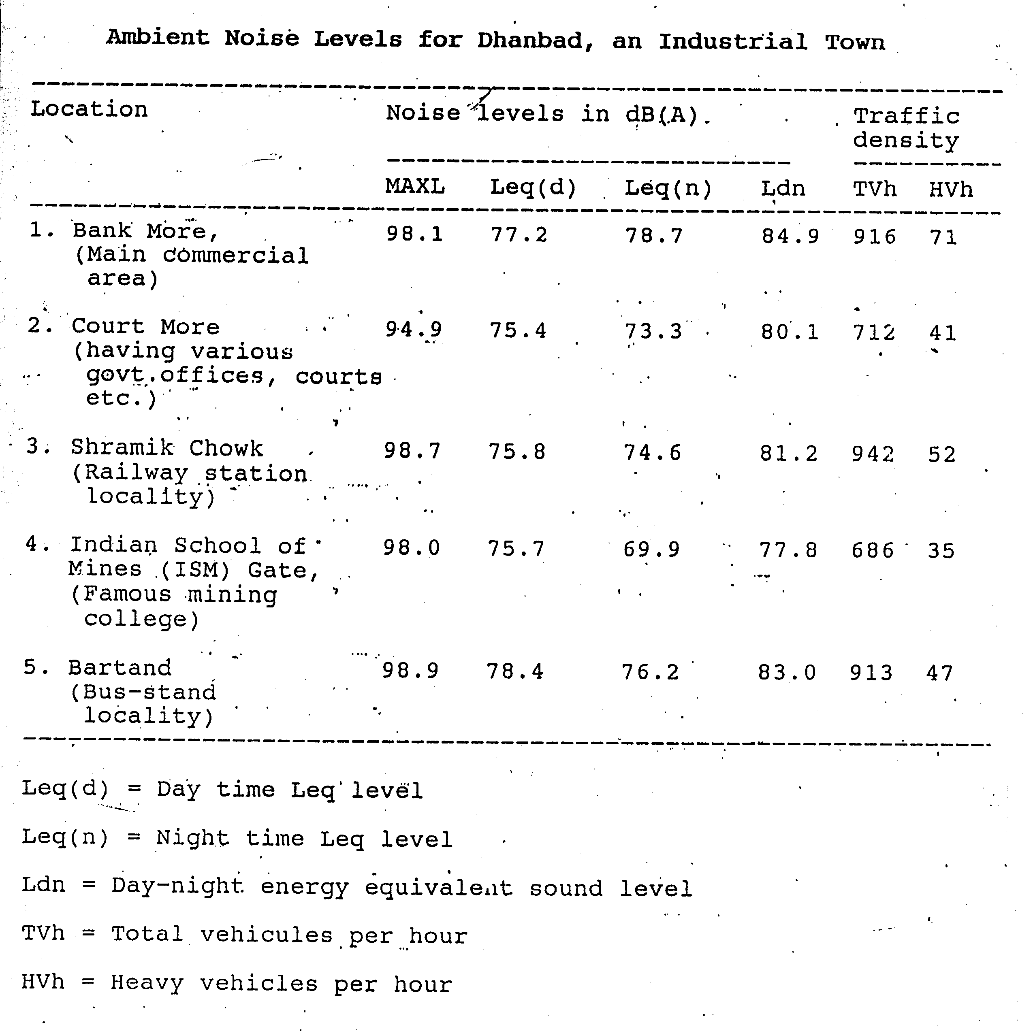

Slide 20

Noise Impact Index ( NII)
Fractional impact method ( Schultz, 1987)
LWP – Sound level weighted population
LWP = x W (Ldn)_{I}
P (Ldn) _{i} = Population distribution function – population strenth in sub neighbourhood I
W (Ldn)_{i} = Weighting function that characterises the severity of the noise impact as a function of Ldn. This takes into account the general adverse reaction of the people to noise which includes spech interference , sleep interference, frustration of desires etc.
NII = LWP / P_{total}

Slide 21
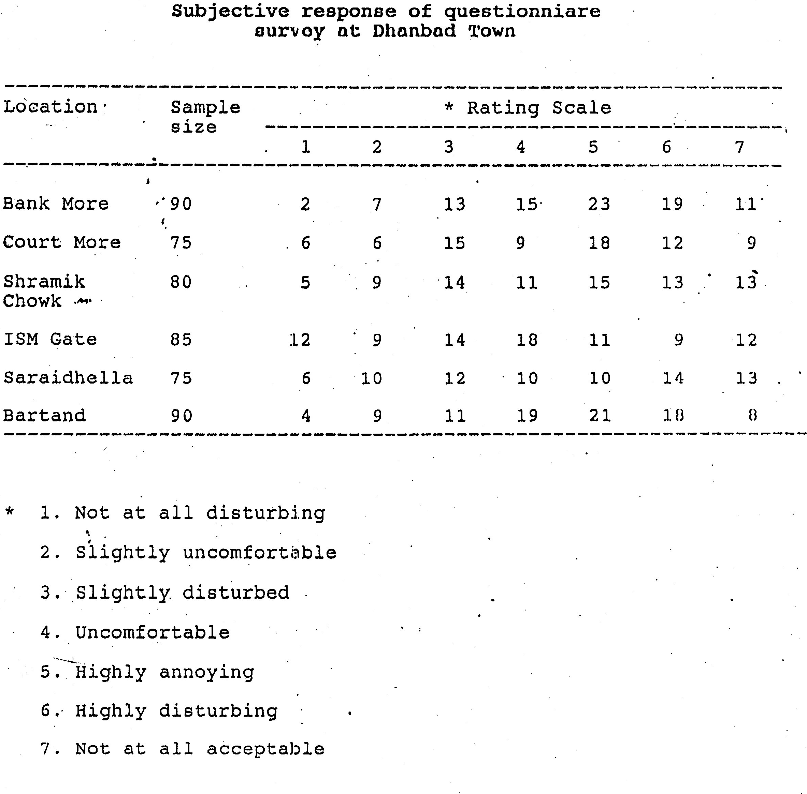

Slide 22
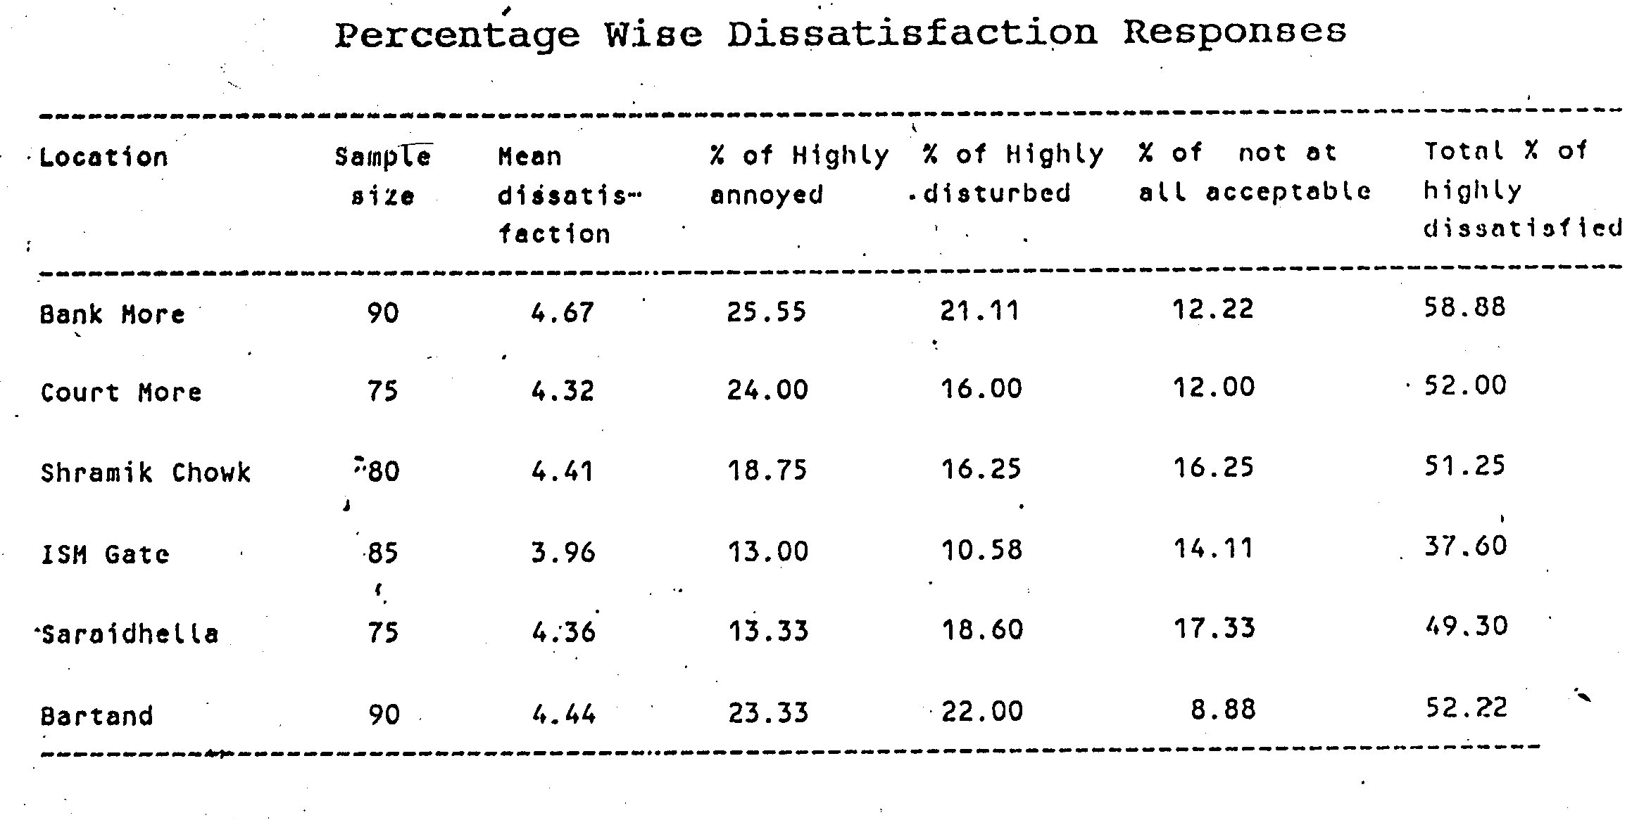

Slide 23
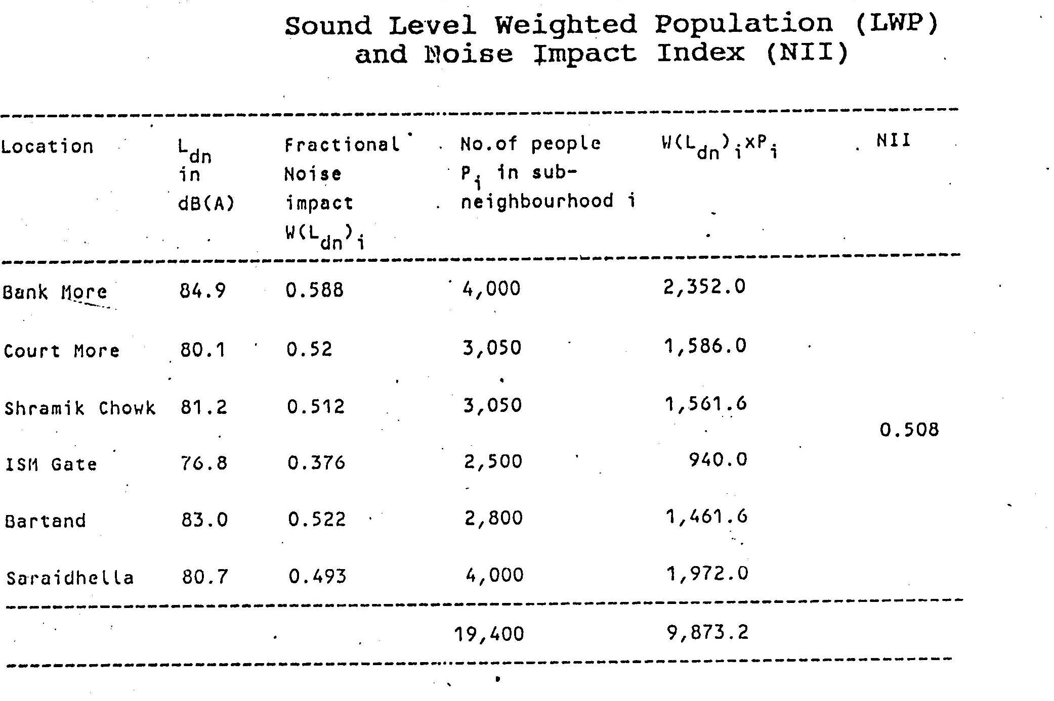

Slide 24
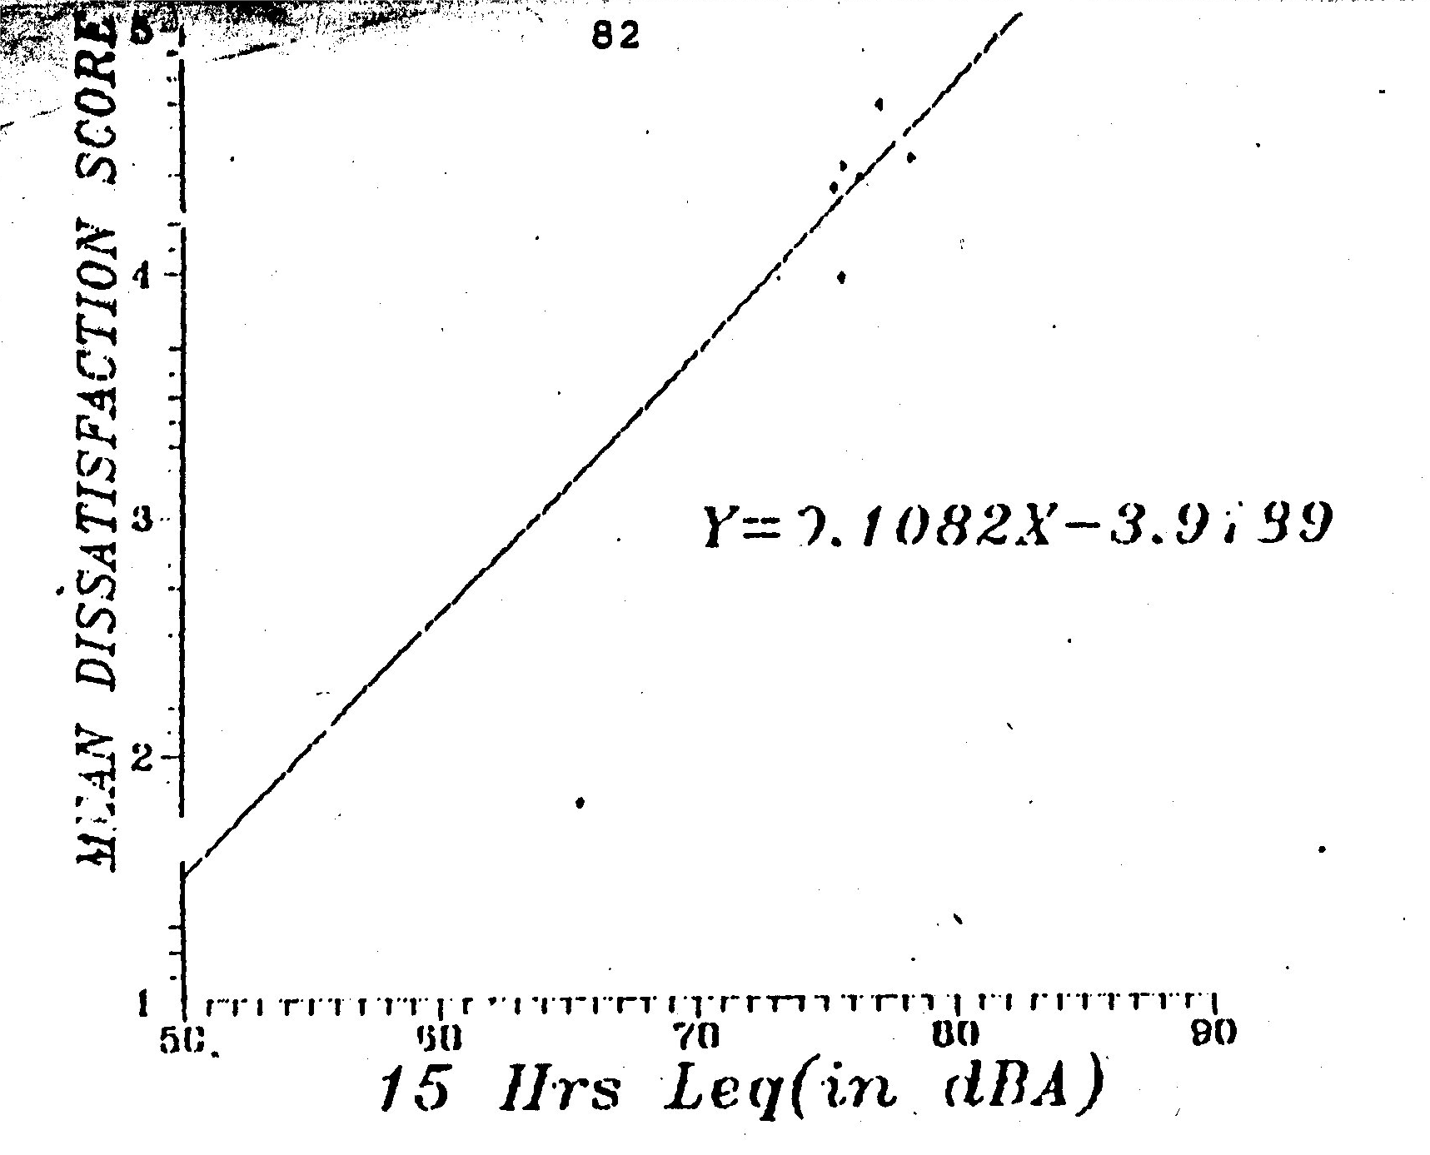

Slide 25
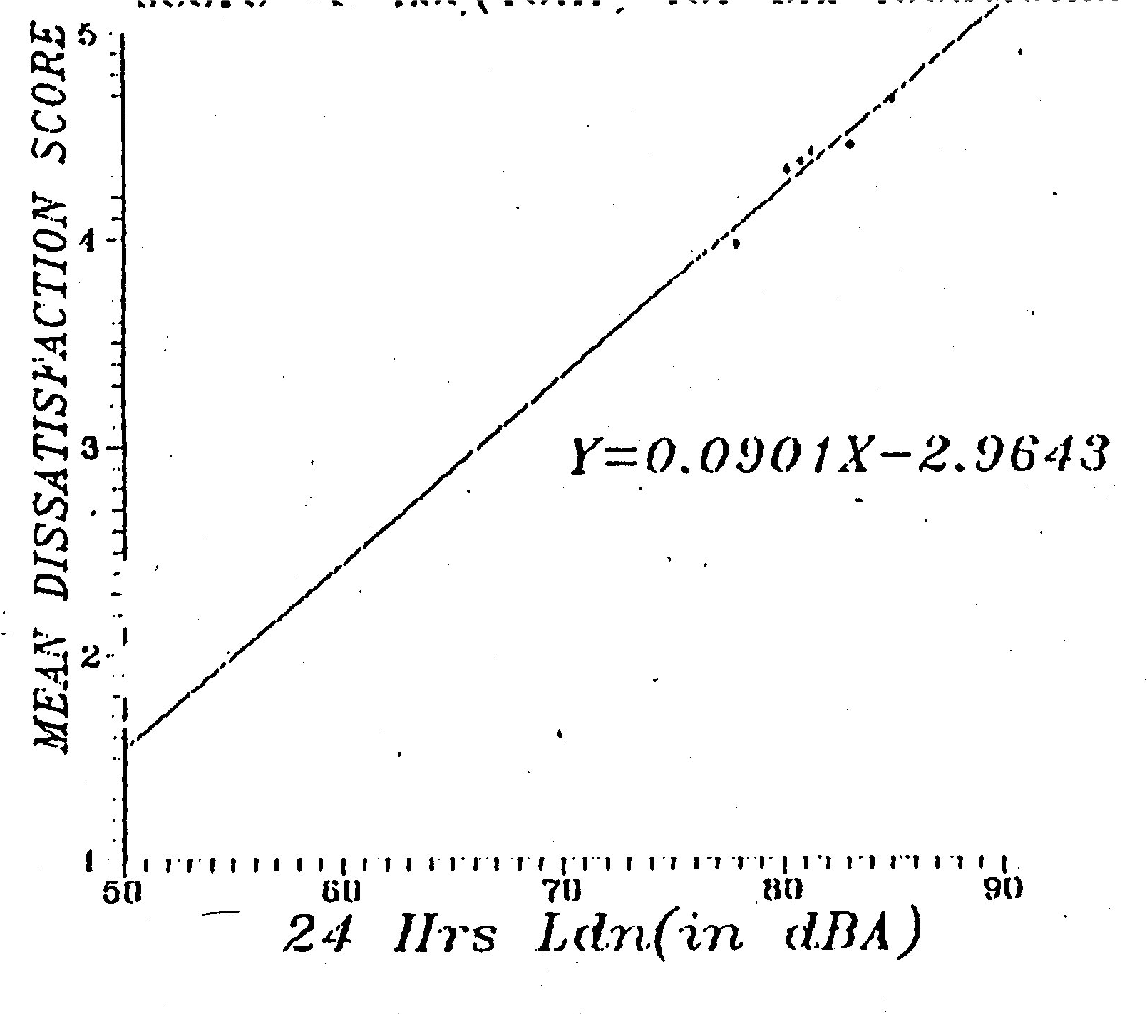

Slide 26
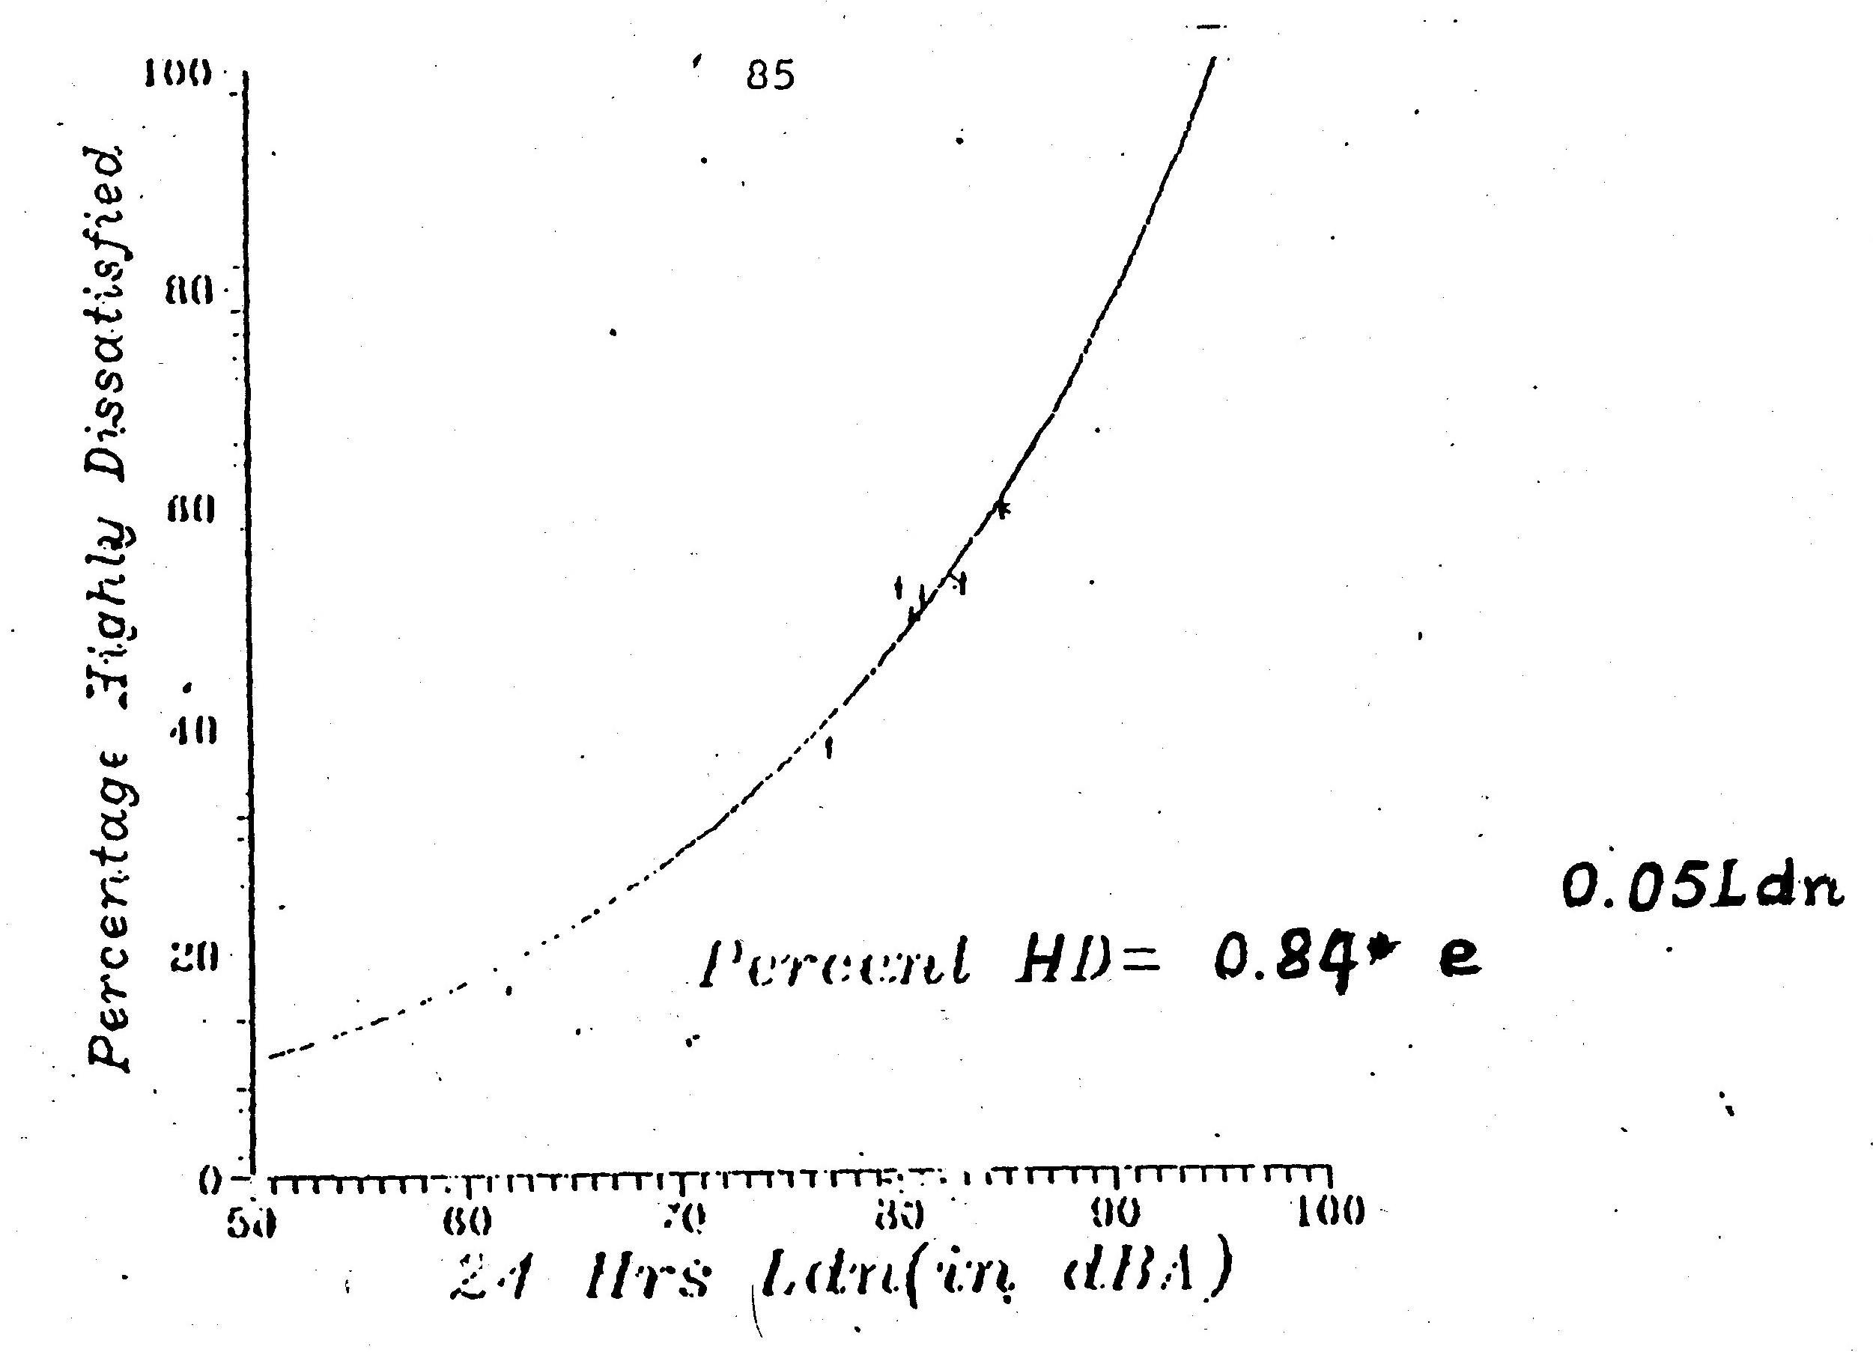

Slide 27
Noise Model for Mining Complex
Basic Features of the models
Determination of sound power , Lw
Computation of total atmospheric attenuation for a given environmental scenario by calculating the individual attenuation components, Kj as follows
      Geometric spreading K1
      Source directivity K2
      Enclosure K3
      Barrier ( building topography) K4
      Air absorption k5
      Wind and temp, gradients, k6
      Ground attenuation k7
3. Computation of the resultant sound pressure level at an environmental point

Slide 28
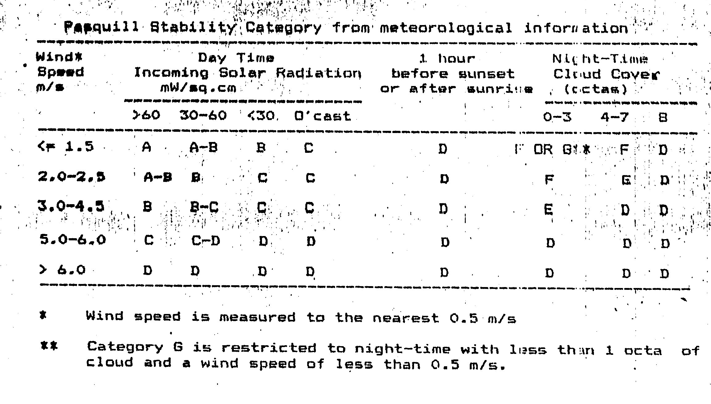

Slide 29
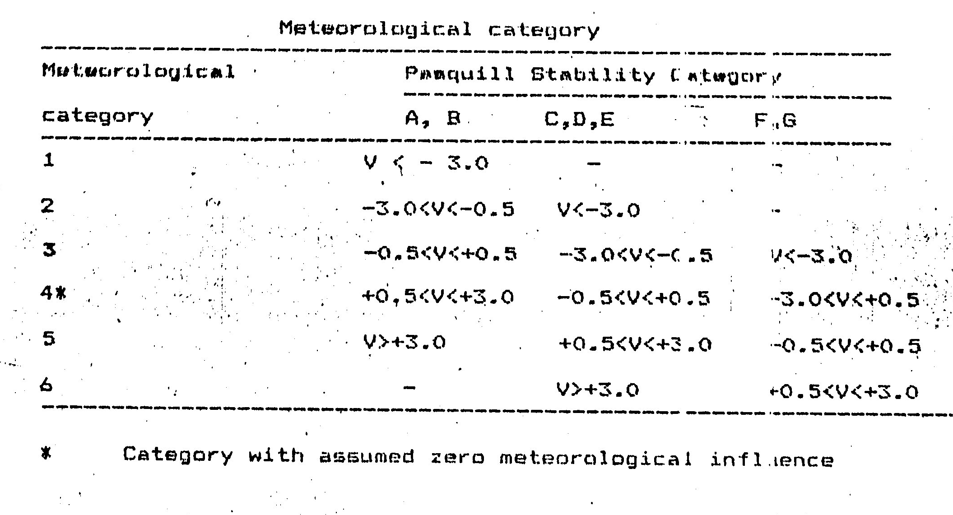

Slide 30
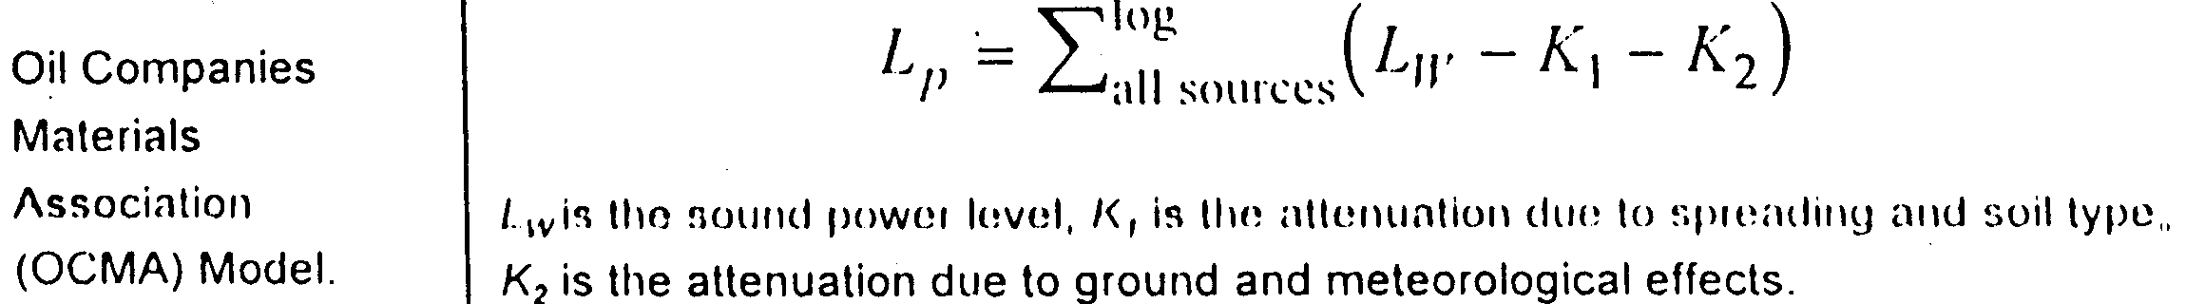
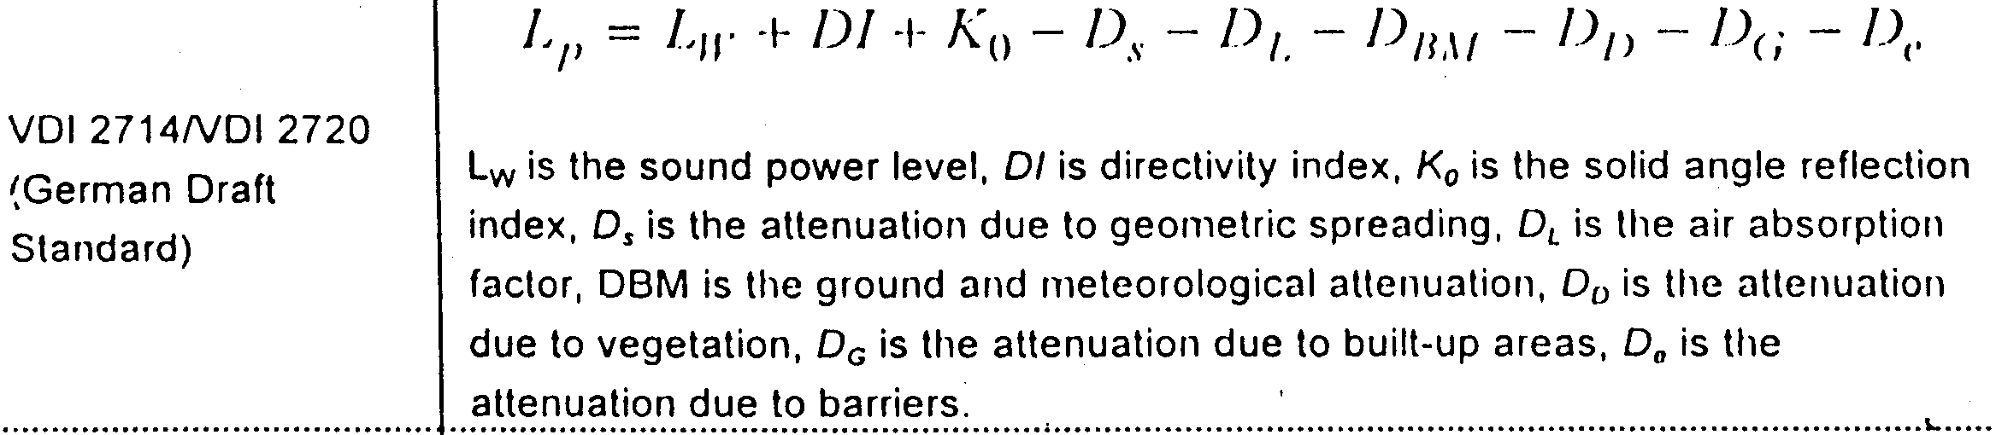

Slide 31
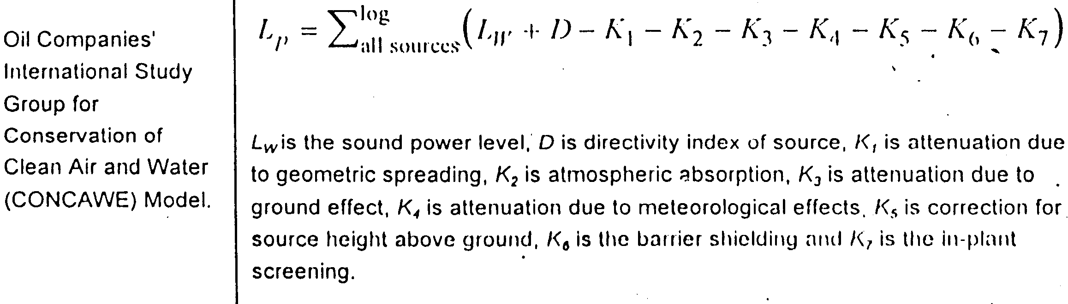
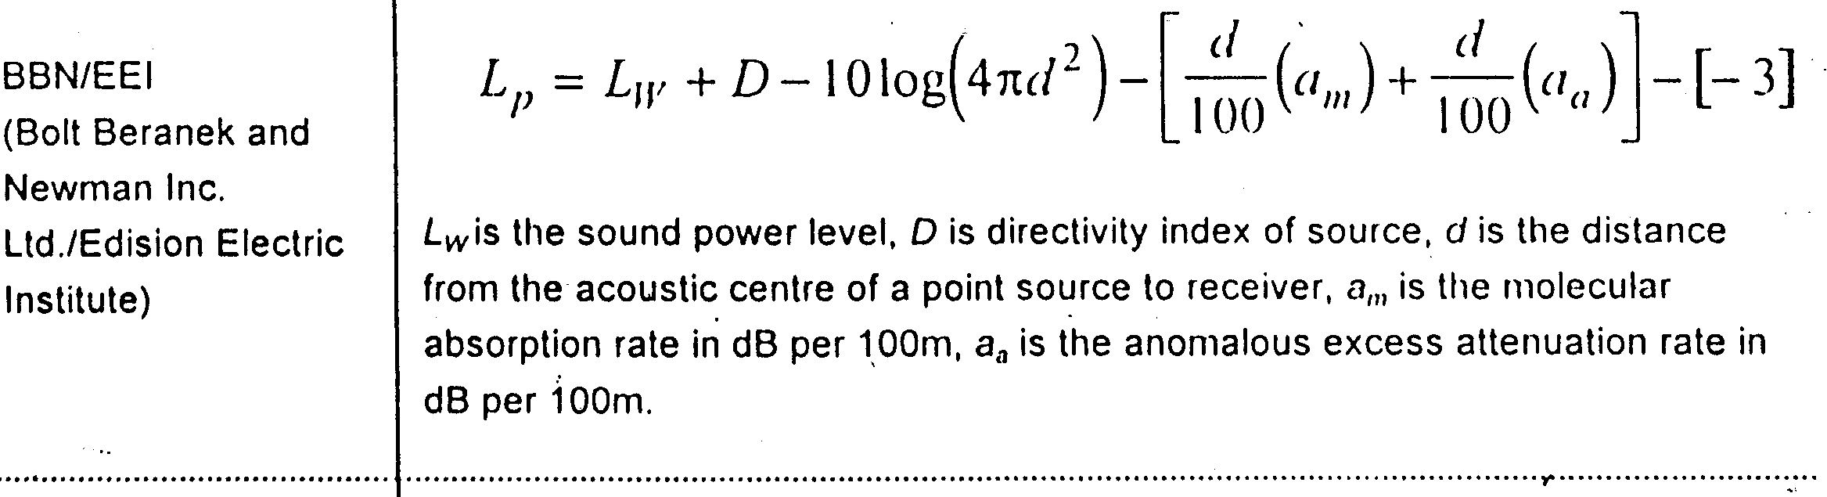

Slide 32
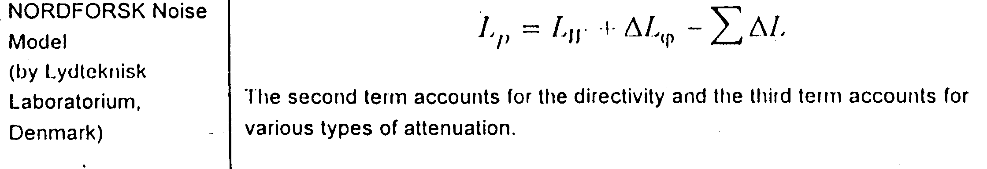
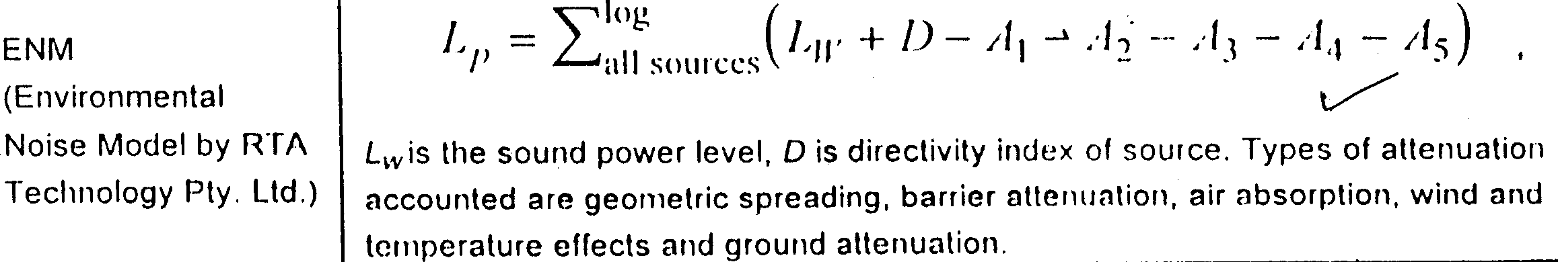

Slide 33
Human vibration
Hand induced vibration
Whole body vibration
Ground vibration prediction
Air blast and its control

